Slide 1
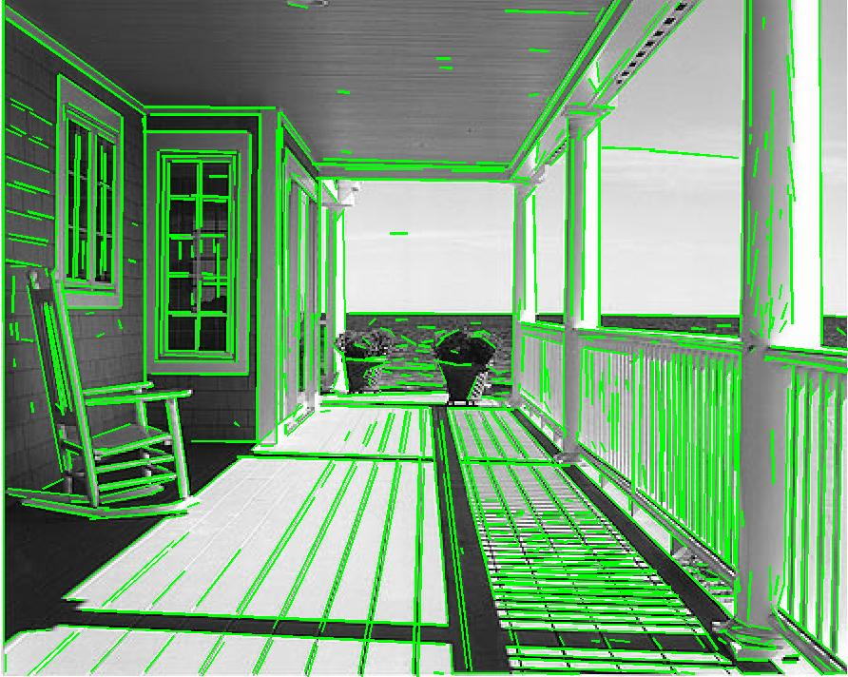
HOUGH TRANSFORM
PRESENTED BY
ABHISHEK K R-193310005
SANJEEV EKKA-193310021
DHARMENDRA KUMAR-193310014

Slide 2

ALGORITHM
We created a sample image using MS word.
GRAY LEVEL-200
GRAY LEVEL-50

Slide 3
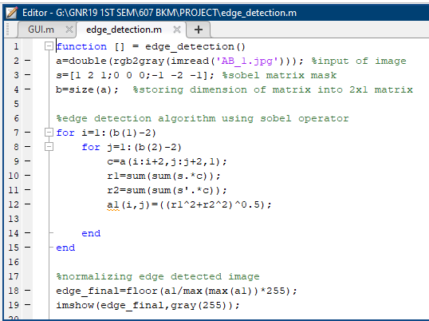

ALGORITHM
2. We applied sobel operator to get edge detected image.

Slide 4
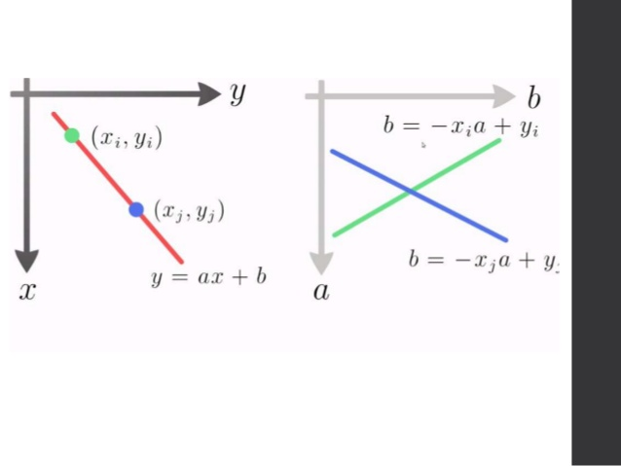
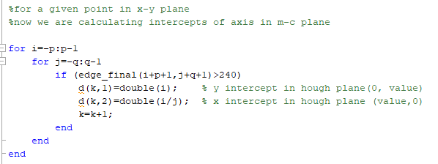
ALGORITHM
3. We divided the image into 4 quadrants with center as origin.
4. Every point in x-y plane represents a Line in Hough plane, so a point (x,y) in x-y plane was stored in intercept form in m-c plane.
A point (x,y) in x-y plane ------ represents a line with intercept coordinates (y/x,0) & (0,y) in m-c plane.

Slide 5
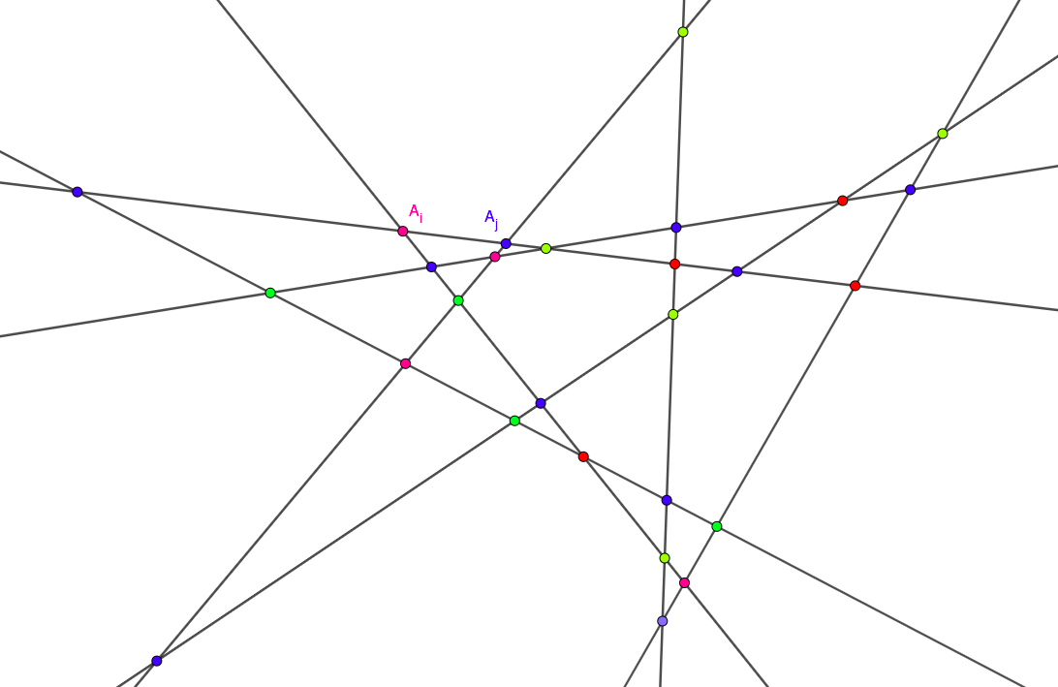
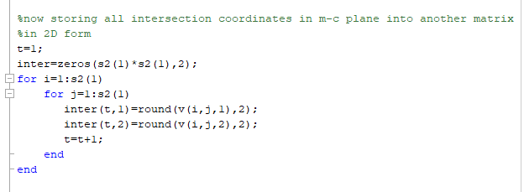
ALGORITHM
5. All the lines(n) corresponding to each edge pixels will have nC2 combinations of intersections, so all the possible intersection coordinates were stored in a matrix.

Slide 6
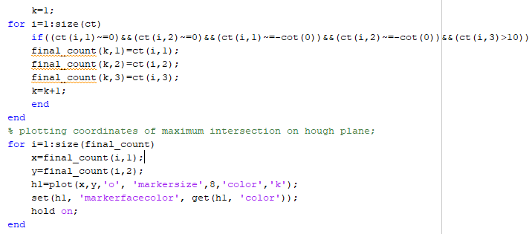
ALGORITHM
5. Then all the unique intersection coordinates were found out with their count and we sorted the coordinates on basis of count in descending order.
6. A threshold was applied to select only those coordinated having high count.

Slide 7
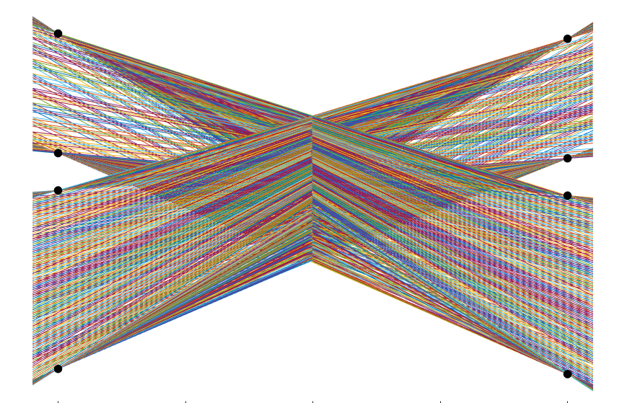
POINT OF HIGH INTERSECTIONS

Slide 8

ALGORITHM
7. Now a point in m-c plane will represent a line in x-y plane, using derived m-c value we plotted line in x-y plane.

Slide 9
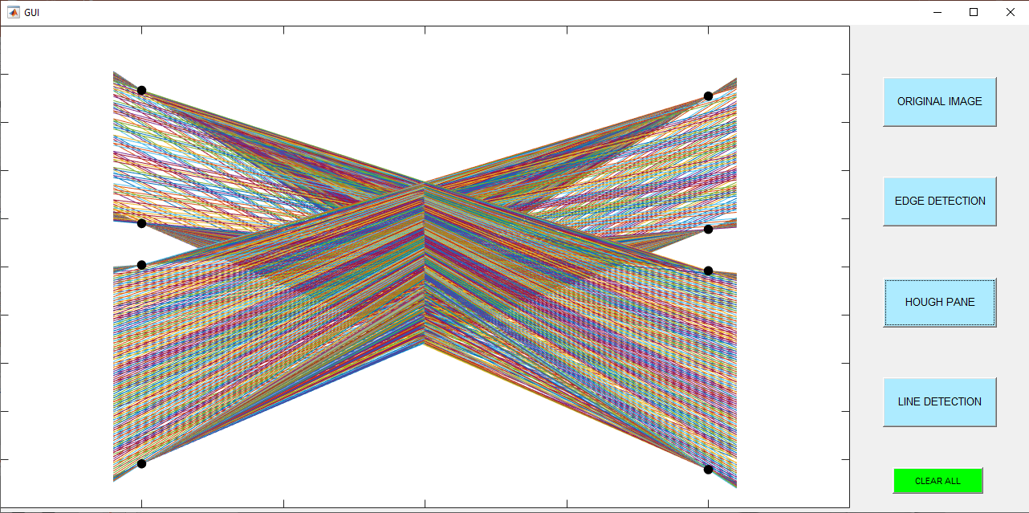
GUI & RESULTS

Slide 10
THANK YOU

